Slide 1

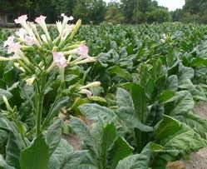
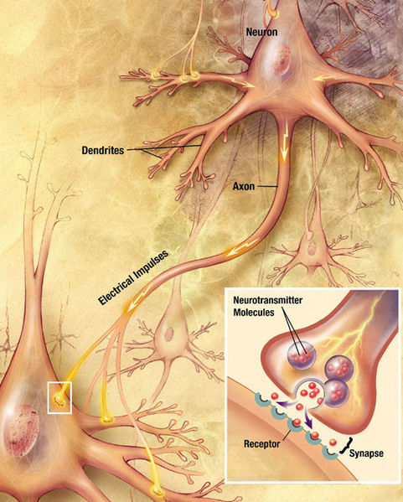
Tabacco Nicotiana
Opium poppy
SECTION VII (CHAP 23)
AMINES

Slide 2
OPIOIDS EPIDEMIC
Opiates are a class of strong painkillers (or analgesic) drugs, derived from the naturally occurring morphine isolated from Opium poppy, including hydrocodone (Vicodin), oxycodone (Oxycontin or Percocet) oxymorphone and codeine.
Codeine is typically used to treat mild to moderate degrees of pain, and it is a cough medicine.

Slide 3
OPIOIDS EPIDEMIC
Fentanyl a newer synthetic opioid painkiller, is 50 to 100 times more potent than morphine and 30 to 50 times more potent than heroin.
Methadone (Dolophine), is another synthetic opioid use for among mild pain and as maintenance therapy to help with tapering in people with opioid dependence.
Methamphetamine is not an opioid but rather a central nervous system stimulant, with psychotic euphoriant and aphrodisiac effects. It is a dangerous neurotoxic agent.

Slide 4
OPIOIDS EPIDEMIC
How do opioids work
They work by sedating and depressing the central nervous system, slowing down body functioning, and reducing physical and psychological pain, by acting upon the opioid receptors in the central nervous system and the brain.
Prolonged usage usually lead to brain damage which stops or slow down the body capacity to produce endorphins, which are natural opiate-type neurotransmitters.
This result in the body becoming unable to manage pain naturally and lead to high amounts of pain when an individual attempts to quit using, also known as opioid withdrawal which can be life-threatening if not done under professional supervision.
Other symptoms includes:
Intense cravings Bone pain
Diarrhea Agitation
Sweating Muscle cramps
Nausea Vomiting

Slide 5
OPIOIDS EPIDEMIC
How to treat overdoses
In the early 1960s, chemists observed that swapping morphine’s methylamine for an allylamine results in a potent opioid antagonist. As such, nalorphine was often used to revers overdoses in new-borns of mothers who had been given opioid pain relievers for childbirth.
Naloxone, the drug current used to reverse overdoses in the fight against opioids epidemic in the USA was synthesized in 1961 by Mozes Lewenstein and Jack Fishman.
Jane Porter and Hershel Jick (10 January 1980). "Addiction Rare in Patients Treated with Narcotics". nejm.org. New England Journal of Medicine. Retrieved 3 June 2017

Slide 6
FUNDAMENTAL CONCEPTS
Classes of amines
Naming amines
Acylation of amines
Nucleophilic substitution on pyridine
Hoffmann and cope elimination
Reductive amination
Acylation - reduction
Gabriel reaction
Hoffmann rearrangement of amide

Slide 7
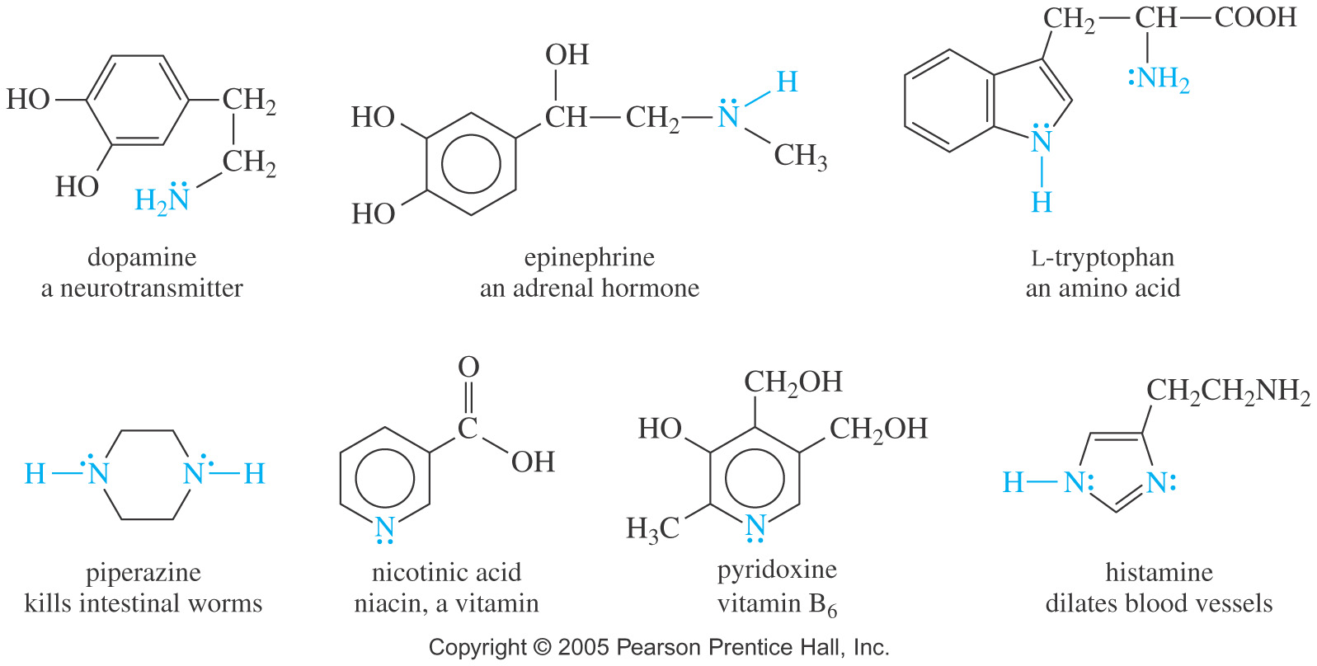
AMINES
Amines are organic derivatives of ammonia with one or more alkyl (or aryl) groups bonded to the nitrogen atom.
Alkaloids are a very important group of biologically active amines, mostly synthesized by plants to protect themselves from insects or animals.
Niacin is one of five vitamins associated with a pandemic deficiency disease: in this case is pellagra (vitamin B3 deficiency). At pharmaceutical doses, it was reported to be associated with hyperglycemia, cardiac arrhythmias, birth defects etc…

Slide 8
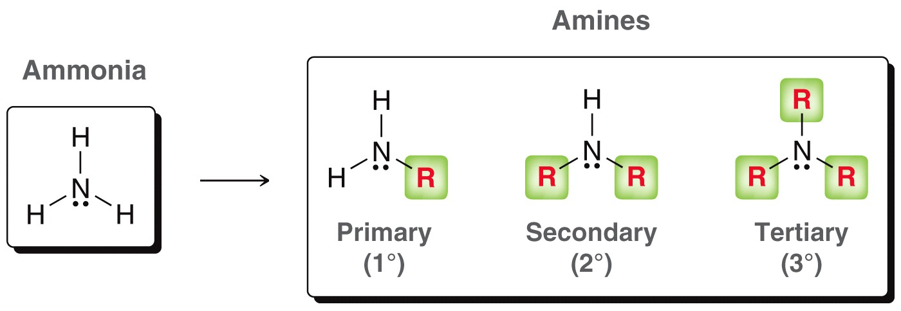
AMINES
Classes of Amines
Amines are classified as Primary (1°), secondary (2°) and tertiary (3°), corresponding to one, two, or three alkyl (or aryl groups bonded to nitrogen.
Primary (1°): one C-N bond, 2 N-H bonds.
Secondary (2°): two C-N bonds, 1 N-H bond.
Tertiary (3°): three C-N bonds, no N-H bond.
Quaternary (4°): four C-N bonds, nitrogen has a + formal charge

Slide 9
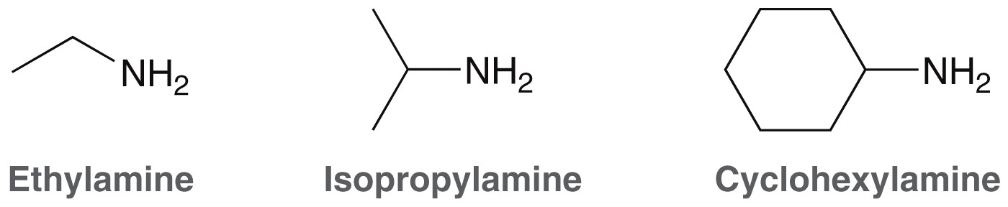
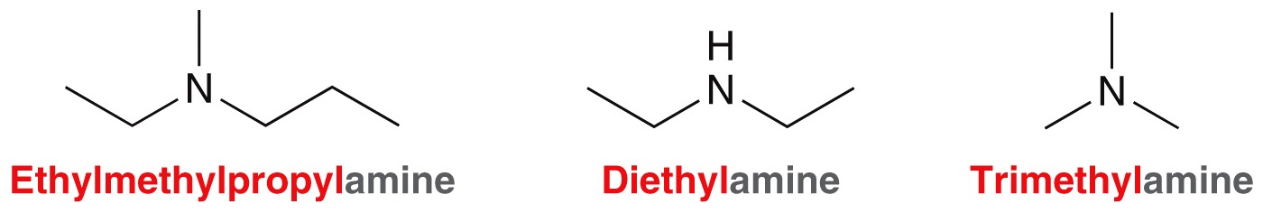
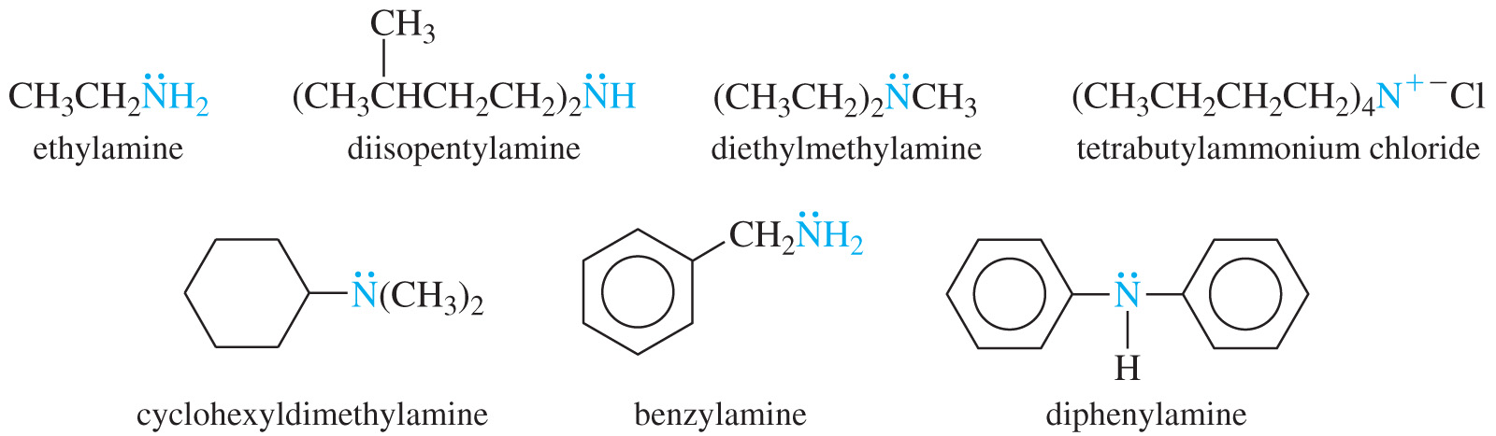
MONENCLATURE OF AMINES
Common Names
Name the alkyl or aryl groups bonded to nitrogen, then add suffix –amine

Slide 10
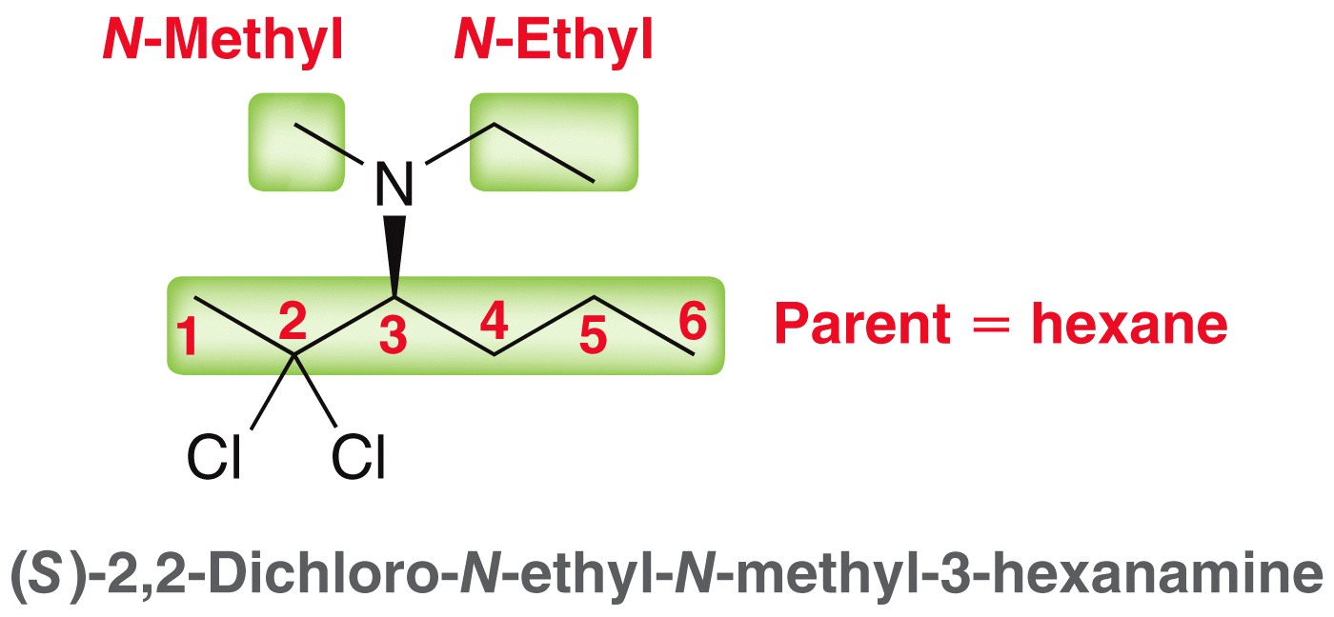
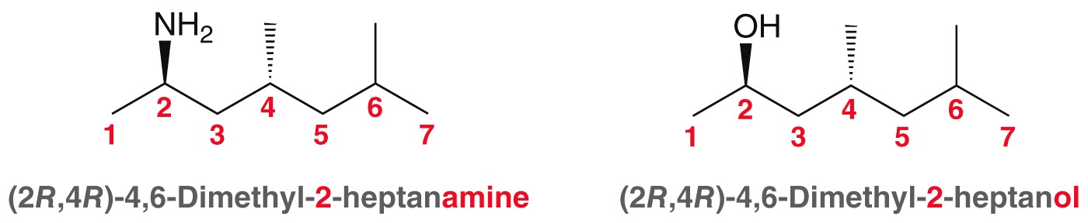
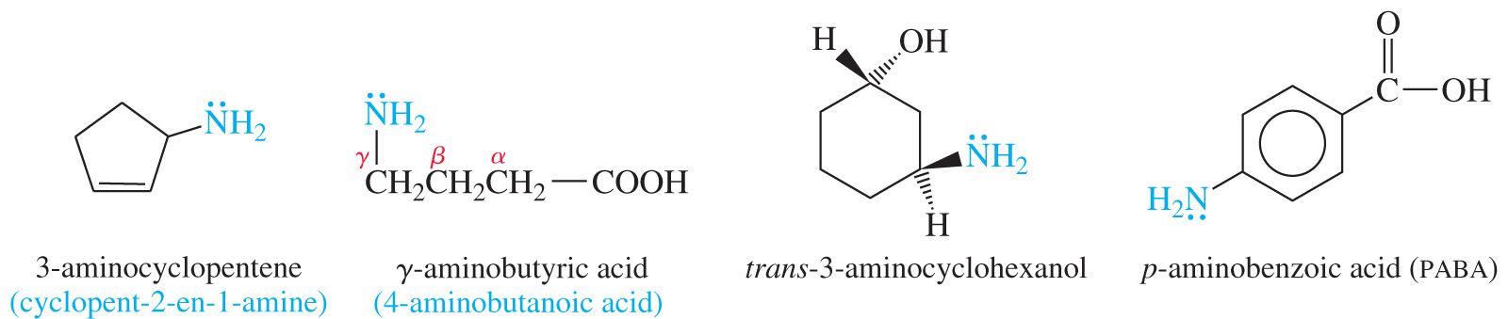
MONENCLATURE OF AMINES
IUPAC Nomenclature
Name is based on longest carbon chain, and replace the -e of alkane with -amine.
Substituents on nitrogen have N- prefix
Amine as Substituent
On a molecule with a higher priority functional group, the amine is named as a substituent using the term “amino”.

Slide 11
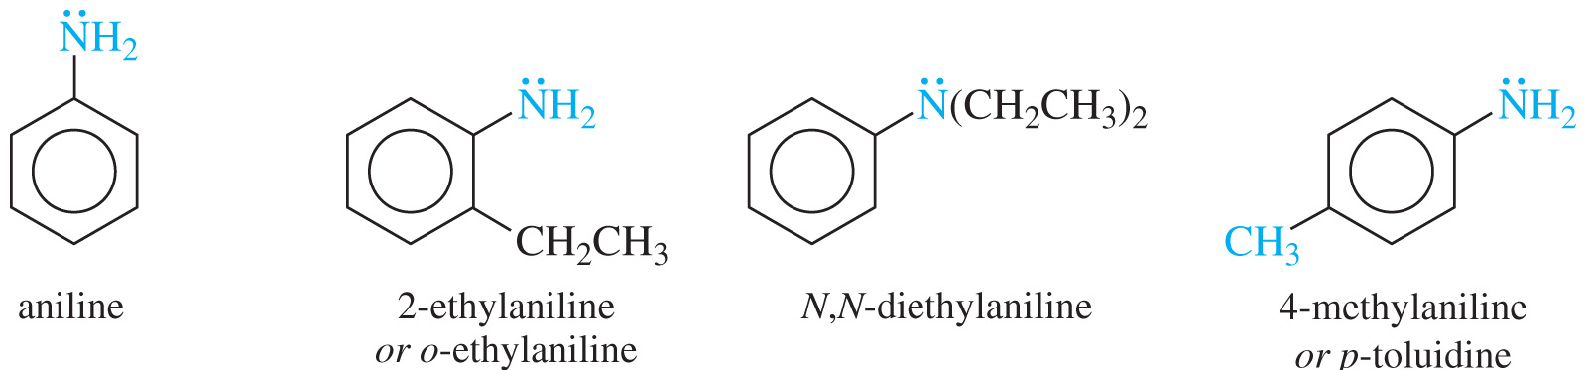
NOMENCLATURE OF AMINES
Aromatic Amines
In aromatic amines, the amino group is bonded to a benzene ring.
Parent compound is called aniline

Slide 12
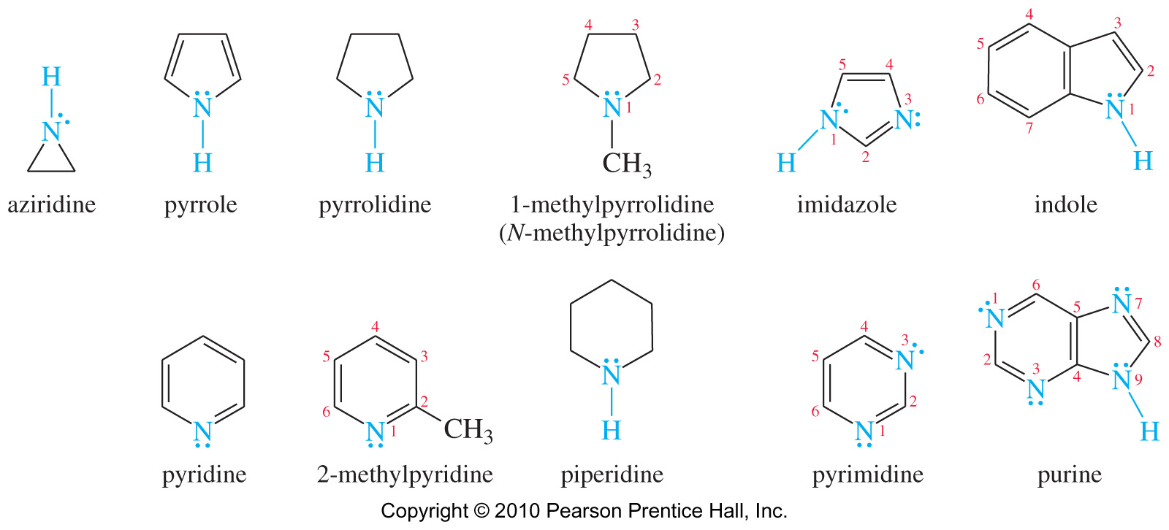
NOMENCLATURE OF AMINES
Heterocyclic Amines
When naming a cyclic amine the nitrogen is assigned position number 1.

Slide 13
NOMENCLATURE OF AMINES
Examples: Name the following compounds
Practice 23.1, 23.2 P. 1107
Problems 23.42, 23.45, 23.47 P. 1145-1146

Slide 14
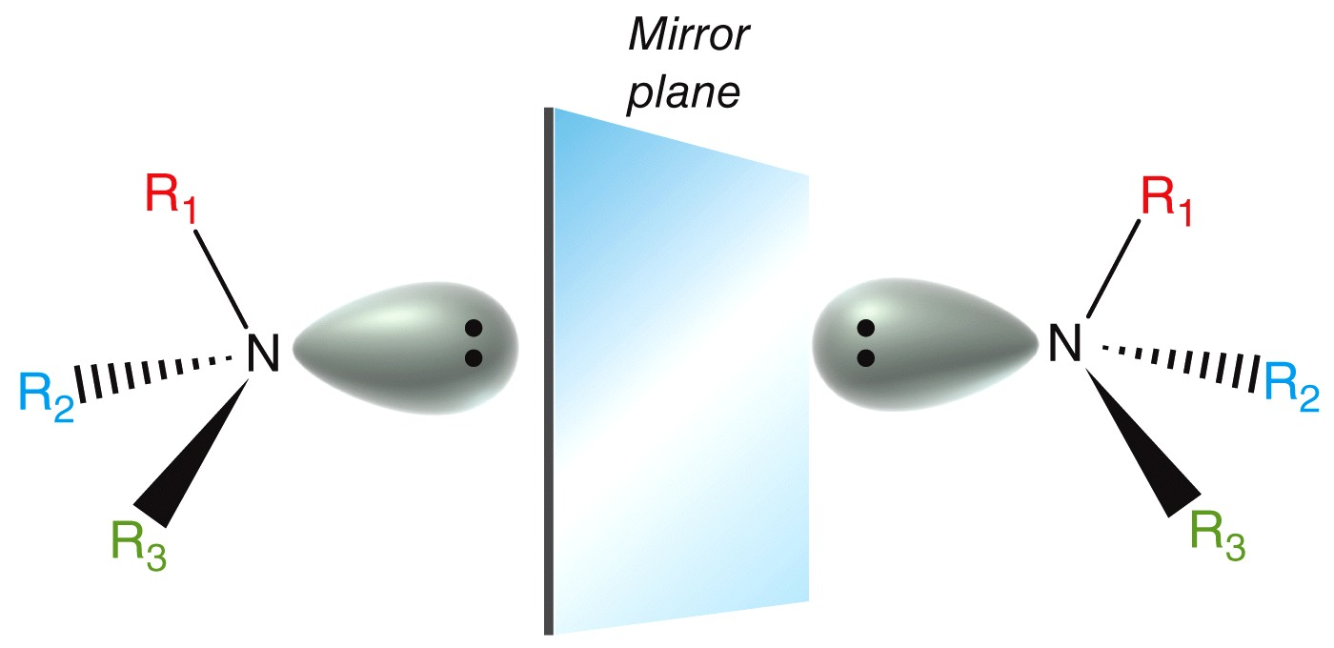
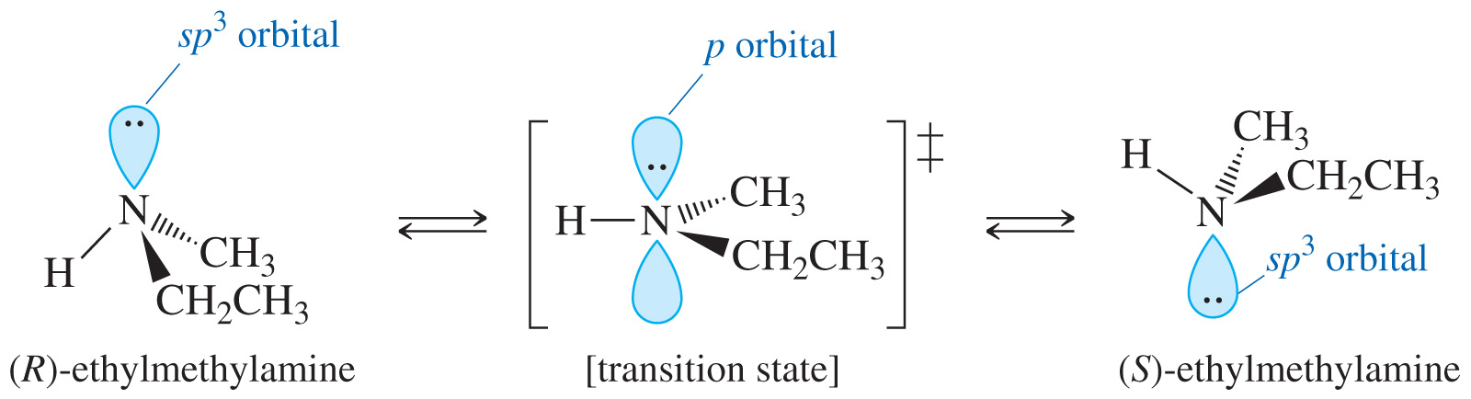
STRUCTURE OF AMINES
Structure of Amines
Chirality of Amines
Nitrogen with three different groups and a lone pair are chiral, but enantiomers cannot be isolated due to inversion around N. As a result, they are optically inactive
Nitrogen is sp³ hybridized with a lone pair of electrons.
The angle is less than 109.5º

Slide 15
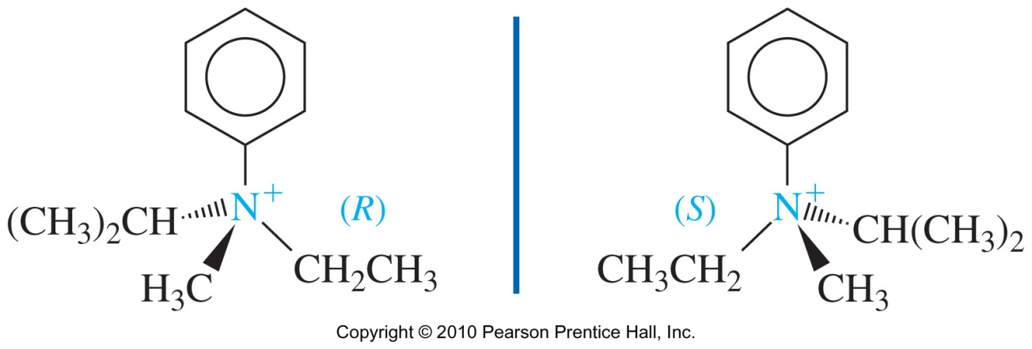
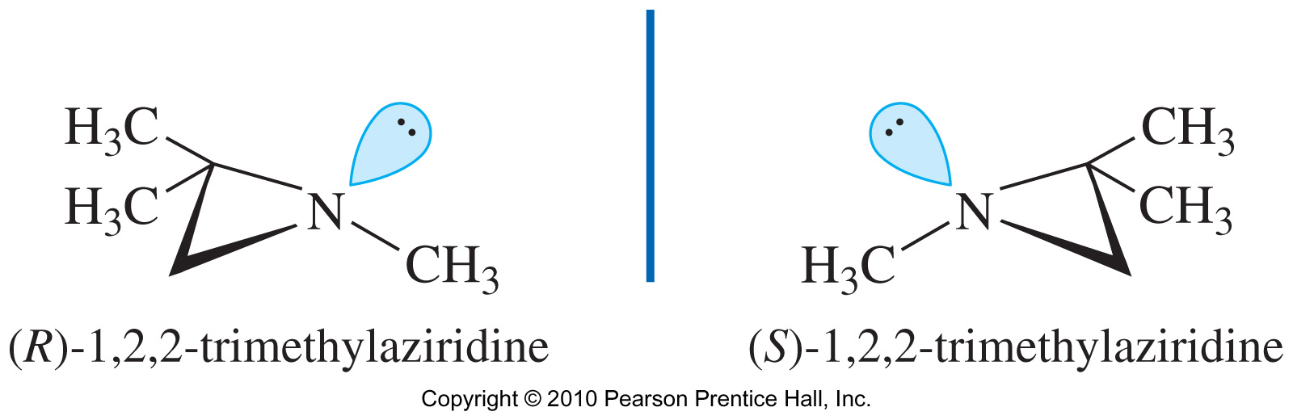
STRUCTURE OF AMINES
Chirality of Amines
If the nitrogen atom is contained in a small ring, for example, it is prevented from attaining the 120° bond angle that facilitates inversion.
Such a compound has a higher activation energy for inversion, the inversion is slow, and the enantiomers may be resolved
Quaternary ammonium salts may have a chiral nitrogen atom if the four substituents are different.

Slide 16
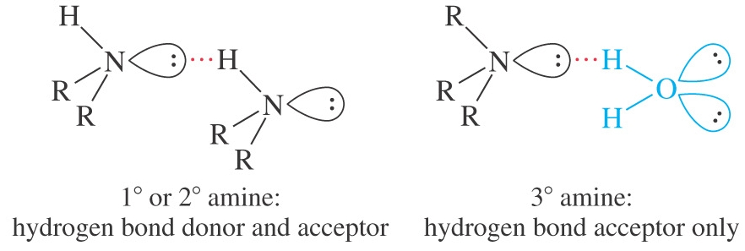
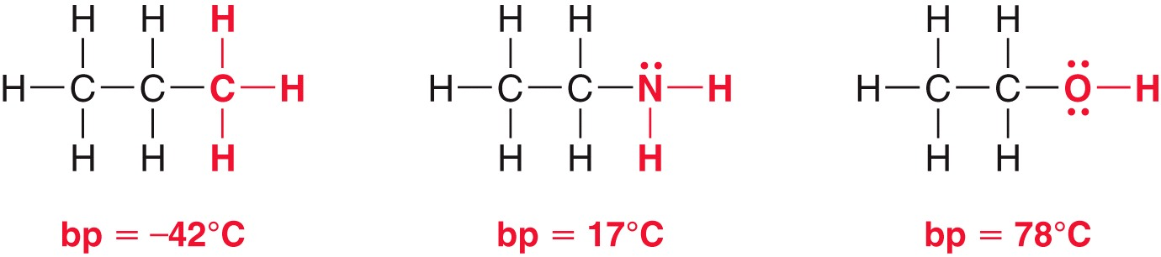
PHYSICAL PROPERTIES
Boiling Points
Amines are strongly polar because the large dipole moment of the lone pair of electrons adds to the dipole moment of the C-N and H-N bonds.
However, N-H is less polar than O-H, forms weaker hydrogen bonds (tertiary amines cannot even form hydrogen bonds, but they can accept hydrogen bonds).

Slide 17
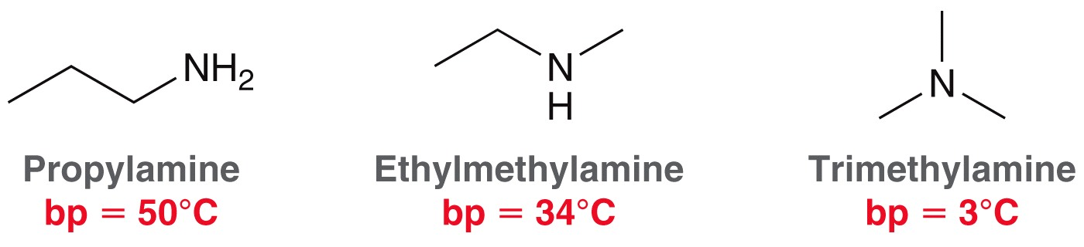
PHYSICAL PROPERTIES
Boiling Points
Practice 23.4, 23.5 P. 1109
Solubility and Odor
Small amines (<6 C) soluble in water.
All amines accept hydrogen bonds from water and alcohol.
Branching increases solubility.
Most amines smell like rotting fish

Slide 18
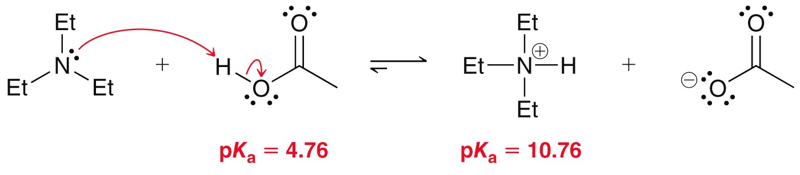
CHEMICAL PROPERTIES
Basicity of Amines
Amine are nucleophiles (Lewis base) because their lone pair of non-bonding electron. Lone pair of electrons on nitrogen can accept a proton from an acid.
Thus aqueous solutions of amine are basic to litmus (Ammonia pKb = 4.74)
Alkyl amines are usually stronger bases than ammonia. Increasing the number of alkyl groups decreases solvation of ion, so 2° and 3° amines are similar to 1° amines in basicity.
Base-Dissociation Constant of Amines
An amine can abstract a proton from water, giving an ammonium ion and a hydroxide ion.
The equilibrium constant for this reaction is called the base-dissociation constant for the amine, symbolized by Kb

Slide 19
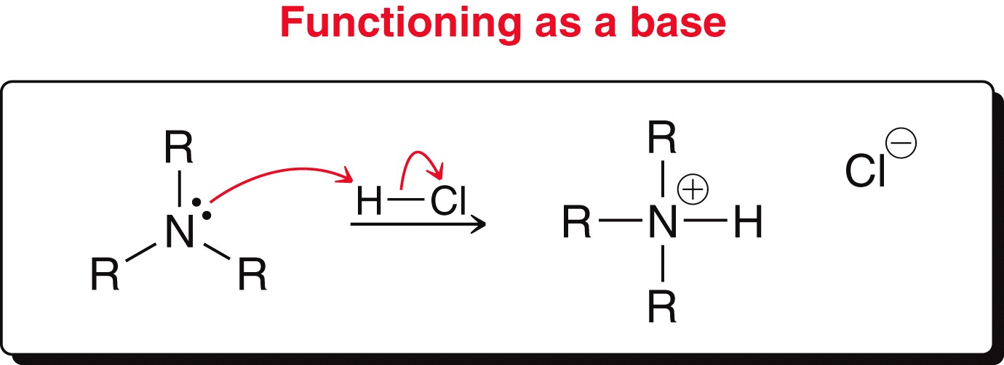
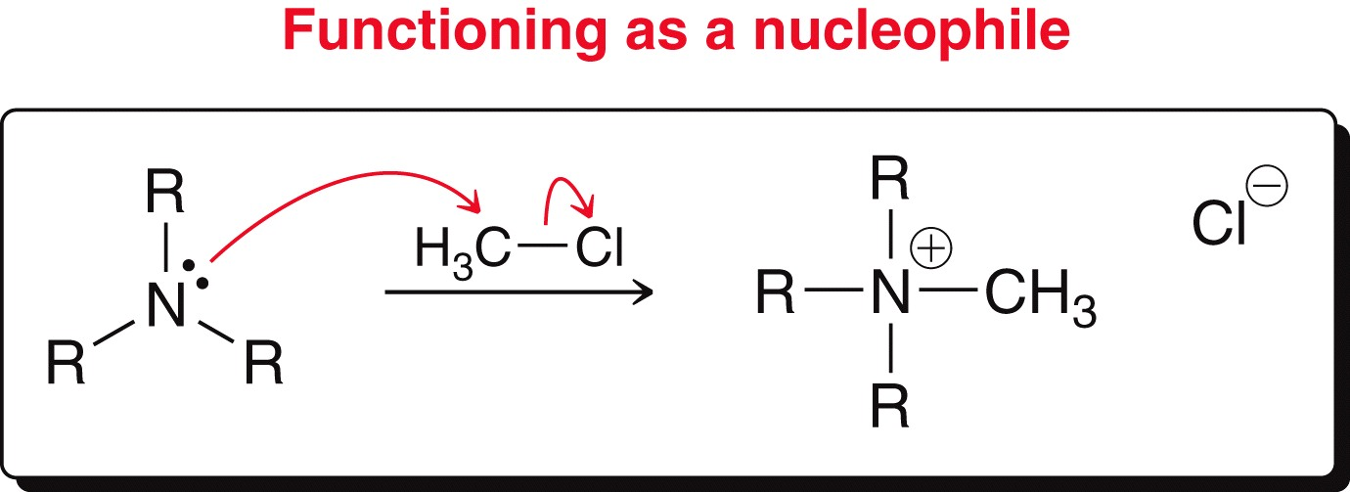
CHEMICAL PROPERTIES
Base Dissociation of an Amine
Alkyl groups stabilize the ammonium ion, making the amine a stronger base
Alkyl groups are electron-donating and stabilize the cation.

Slide 20
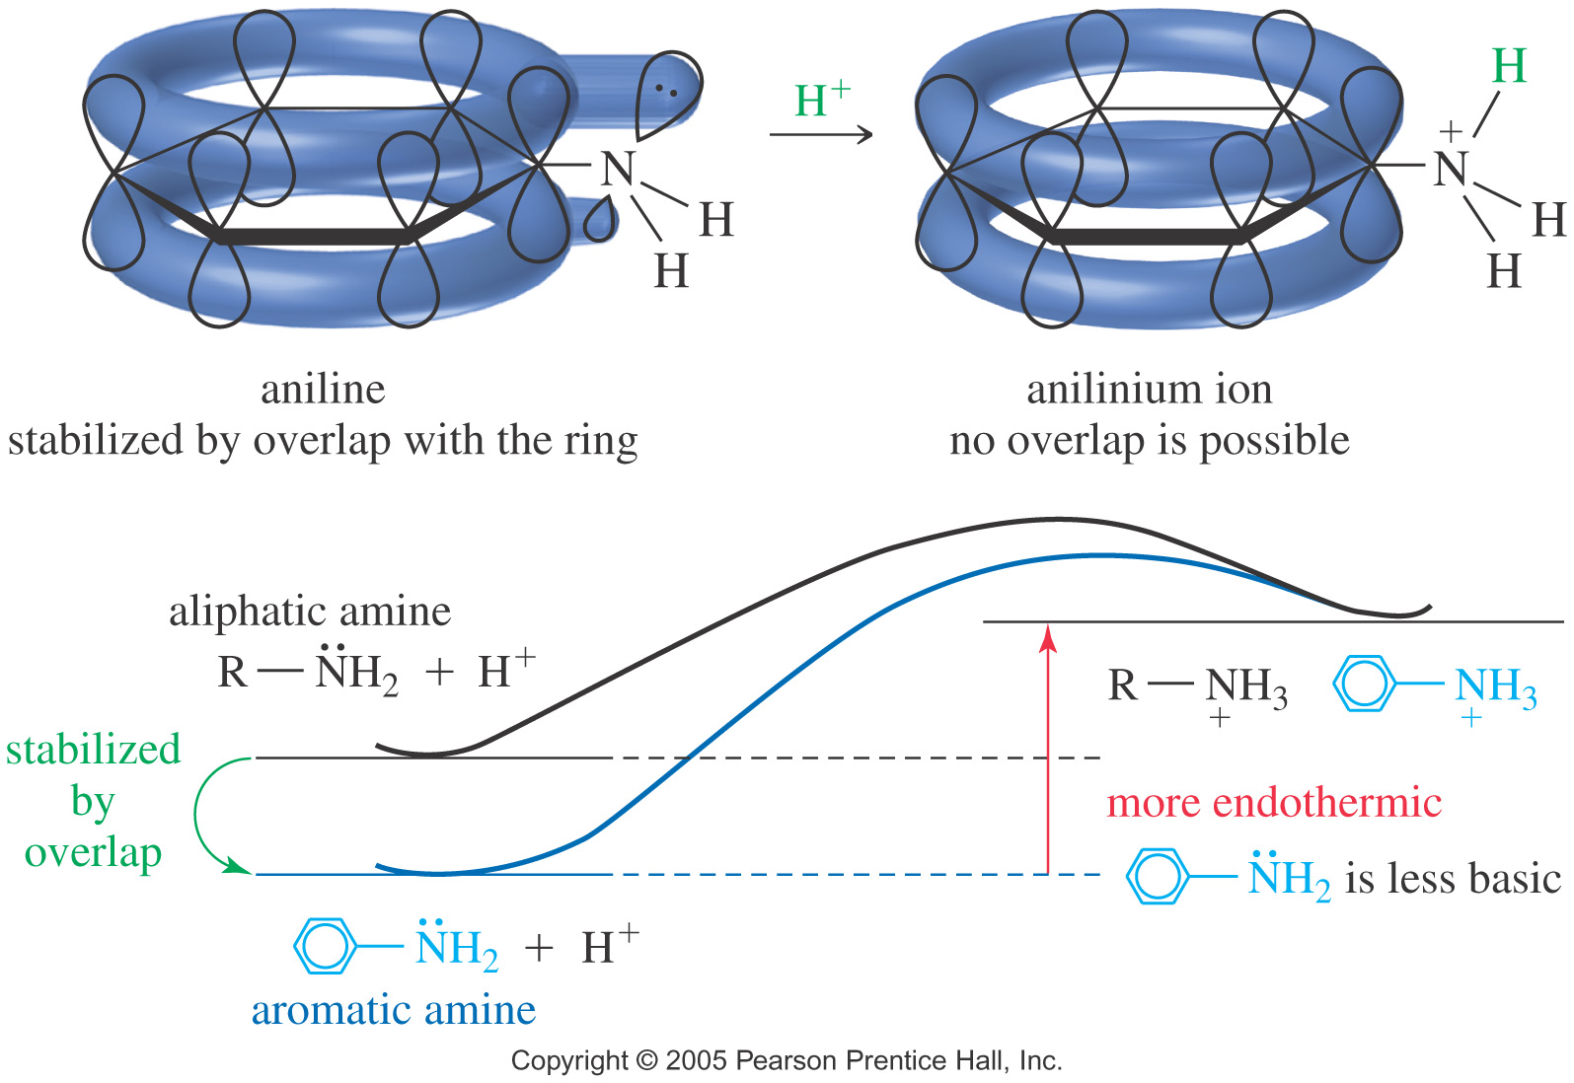
CHEMICAL PROPERTIES
Resonance Effects
Aromatic amines (aniline and their derivatives) are weaker bases than simple aliphatic amine. This is due to the delocalization of the electron pair that weakens the base.

Slide 21
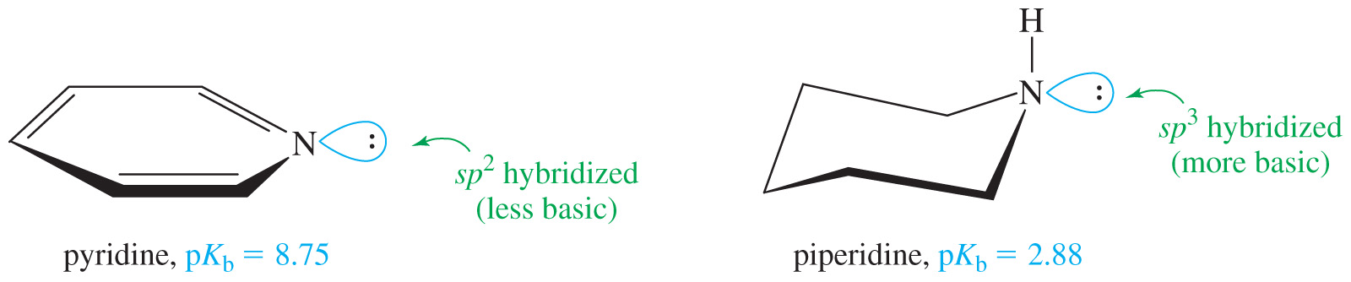
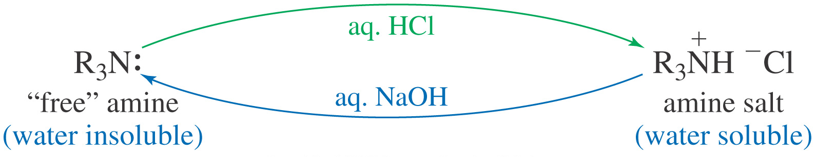
CHEMICAL PROPERTIES
Hybridization Effects
Pyridine is less basic than aliphatic amines, but it is more basic than pyrrole because it does not lose its aromaticity on protonation
Amine Salts
Protonation of an amine gives an amine salt (ammonium salt), which is an ionic solids with high melting points, soluble in water and no fishy odor.
Practice 23.6 to 23.9 P. 1113
Problem 23.41 P. 1145

Slide 22
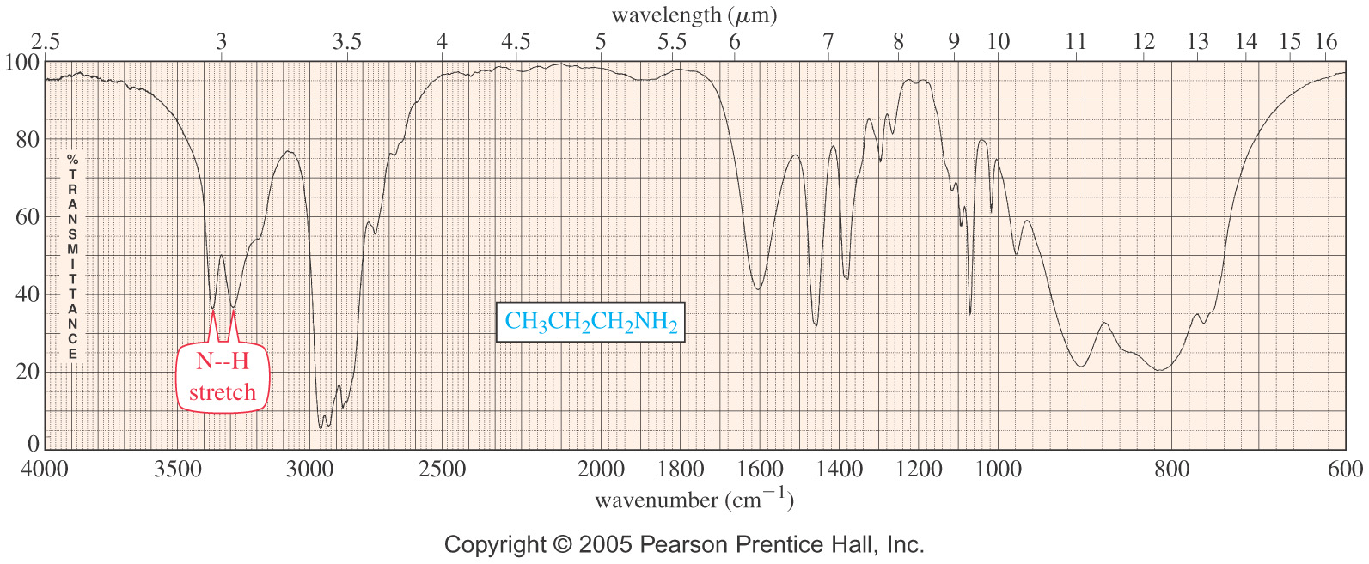
SPECTROSCOPY
IR Spectroscopy
N-H stretch between 3200-3500 cm⁻¹.
Two peaks for 1° amine, one for 2°.

Slide 23
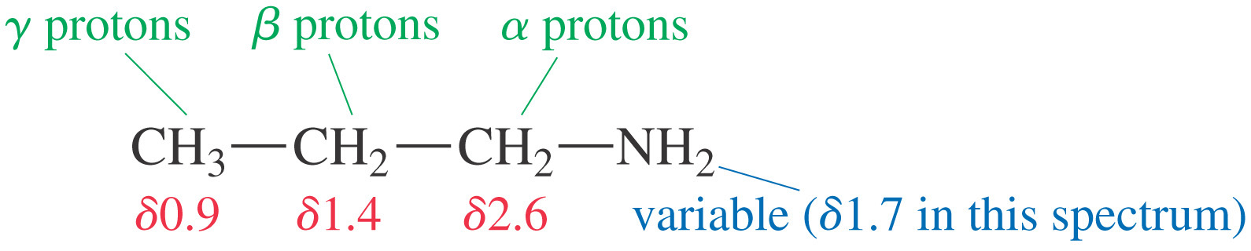
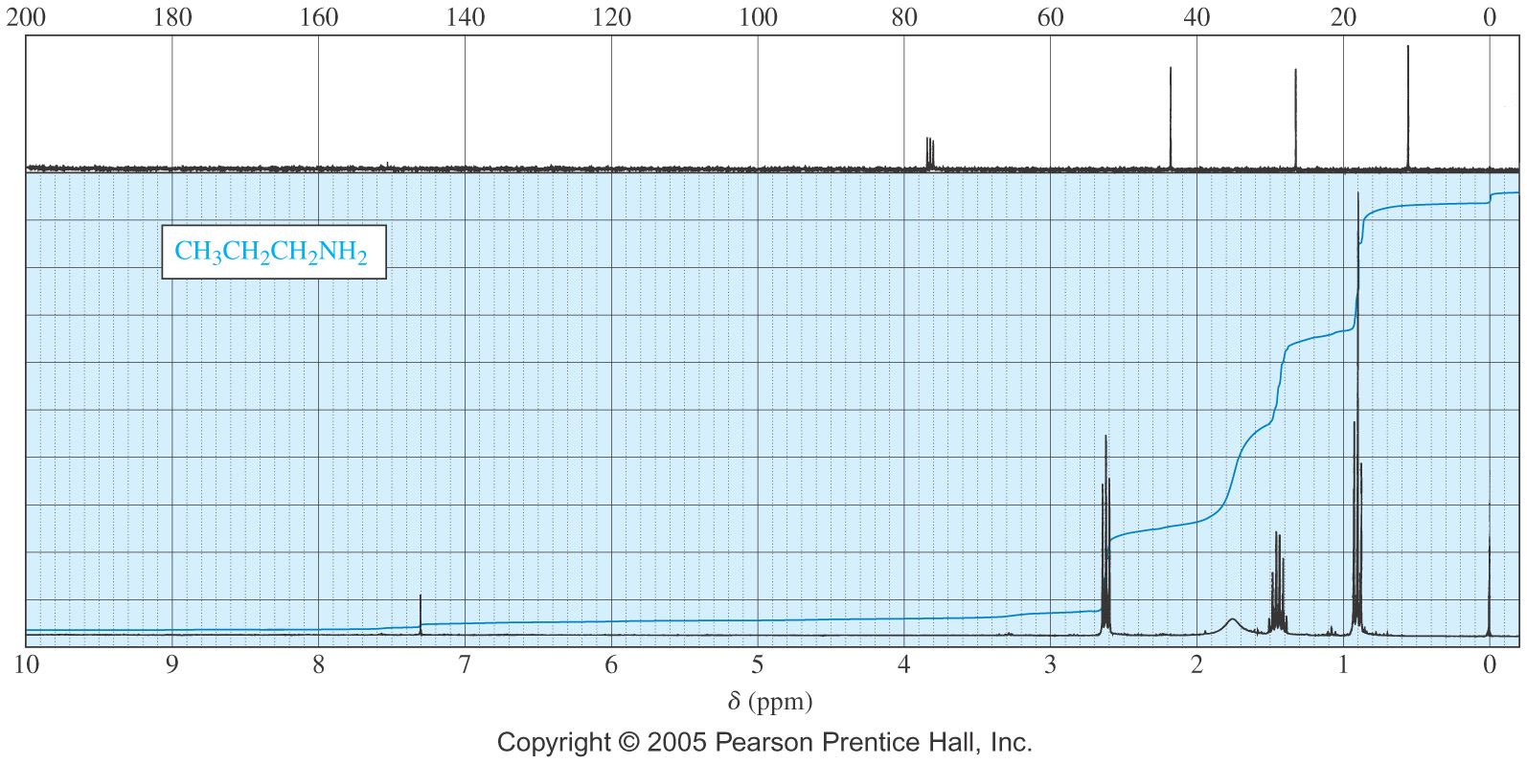
SPECTROSCOPY
NMR Spectrum

Slide 24
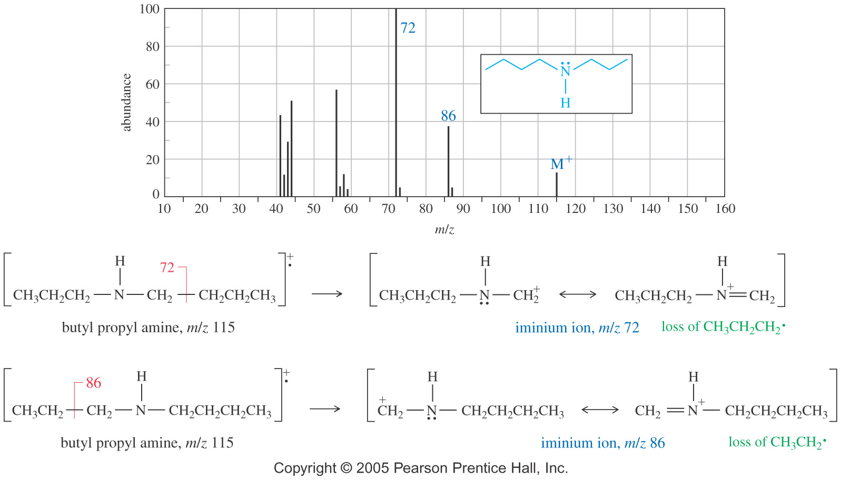
SPECTROSCOPY
Mass Spectrum

Slide 25
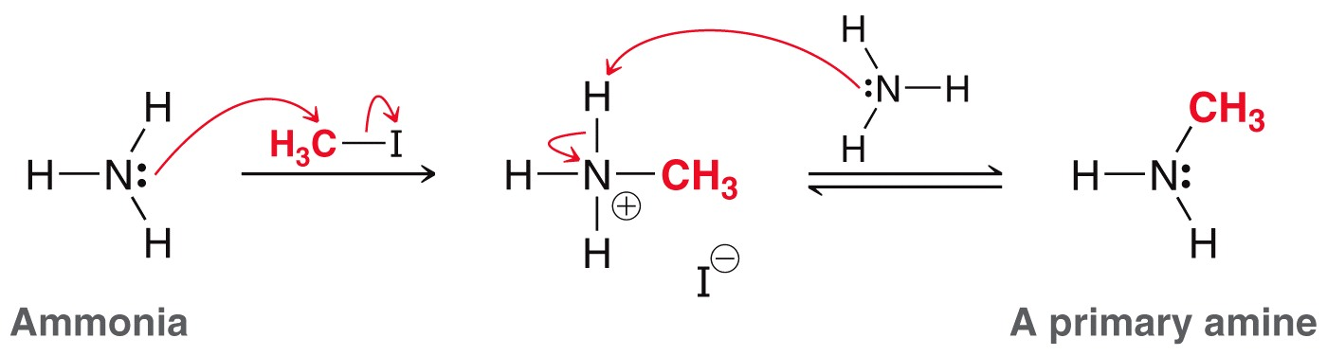
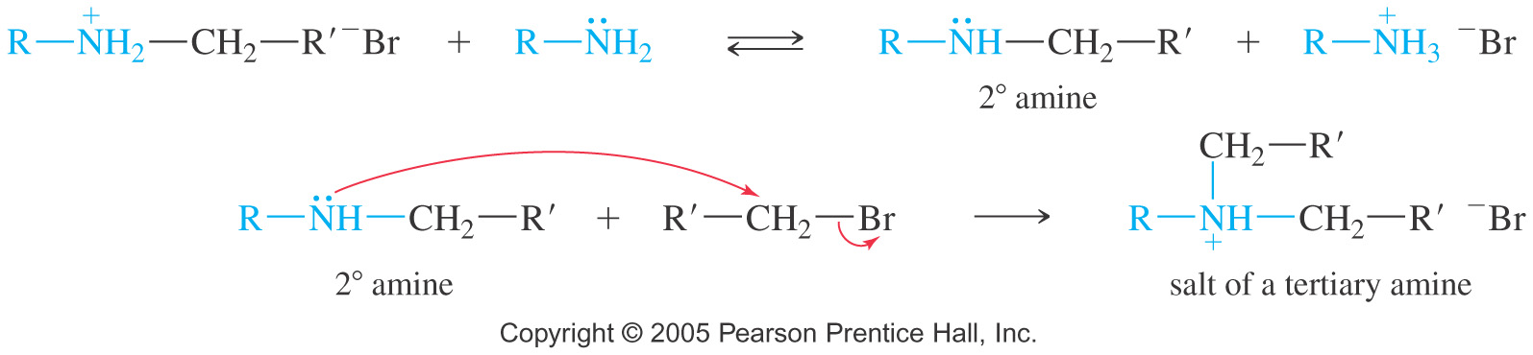
REACTION OF AMINES
Alkylation of amines by alkyl halides
Amines react with 1° alkyl halides via the SN₂ mechanism, and mixtures of the mono-, di-, and tri-alkylated products are often obtained.
Even if just one equivalent of the halide is added, some amine molecules will react once, some will react twice, and some will react up to three times (tetraalkylammonium salt).

Slide 26
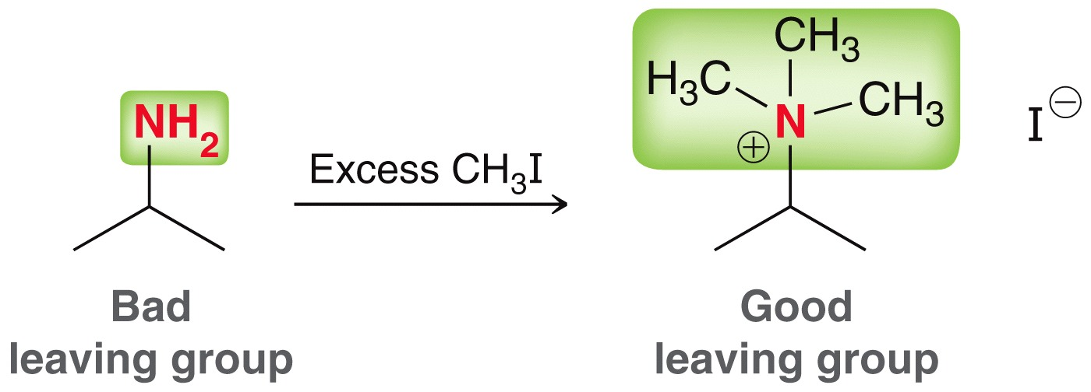
REACTION OF AMINES
Exhaustive alkylation
A mixture of different alkylated products is avoided if enough alkyl halide is added to alkylate the amine as many times as possible.
This exhaustive alkylation gives a tetraakylammonium salt as only product of the reaction.
Reaction with large excess of NH₃ to form the primary amine

Slide 27
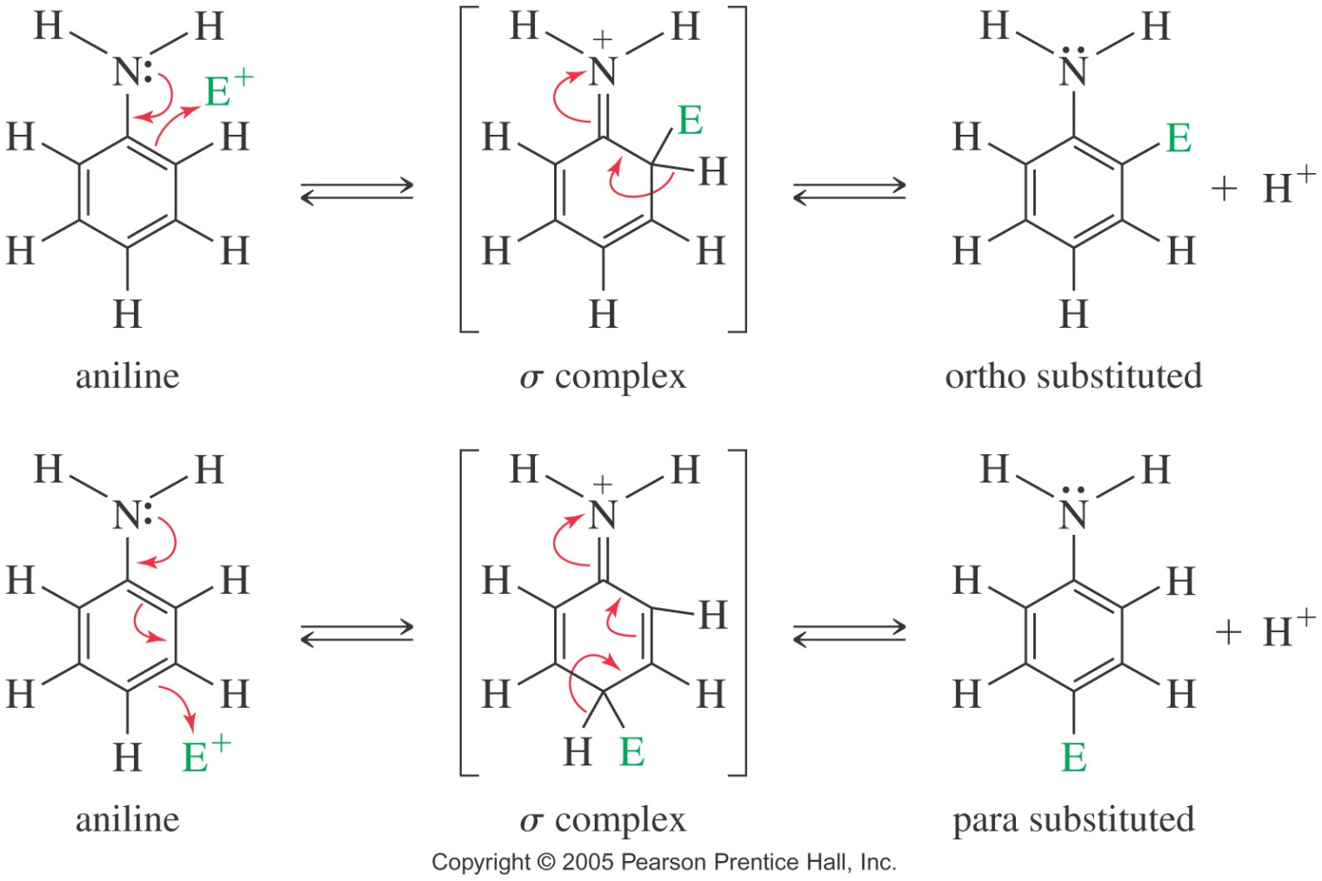
REACTION OF AMINES
Electrophilic Substitution of Aniline
In arylamine, amino groups are strong activating groups and ortho, para-directors. The halogenation of aniline derivatives occurs readily without a catalyst.
If an excess of the reagent is used, all unsubstituted ortho or para-positions to the amino groups become substituted.
Strongly acidic reagents protonate the amino groups, changing -NH₂ to -NH₃⁺, a meta-allowing deactivator.
Attempt to nitrate aniline may explode

Slide 28

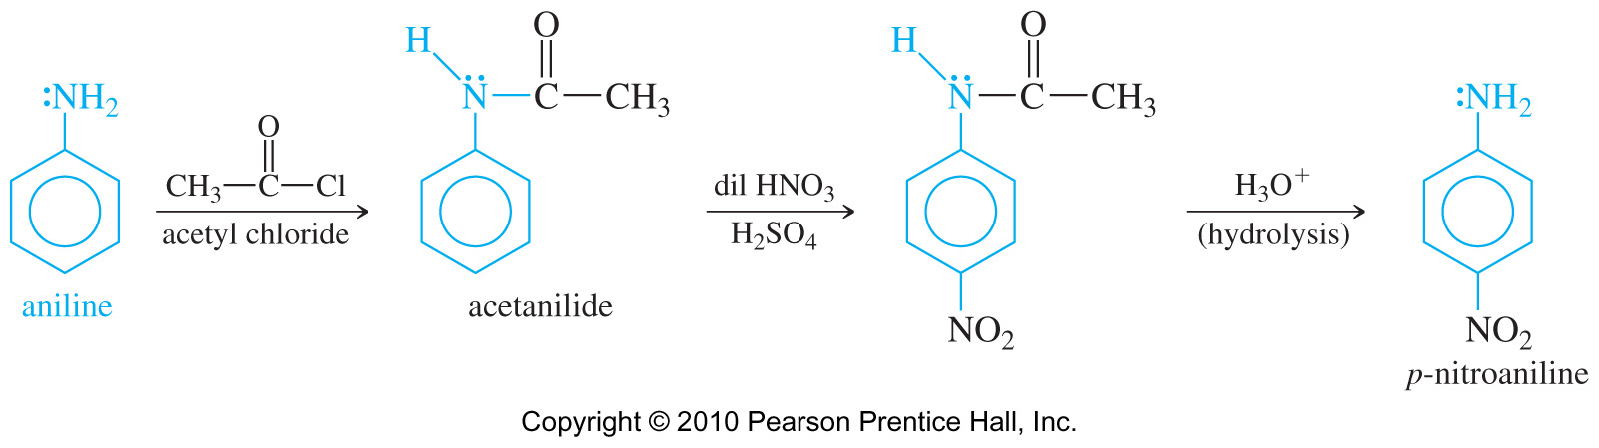
REACTION OF AMINES
Acylation of Amines by Acid Chlorides
Primary and secondary amines react with acid halides to form amides. This reaction is a nucleophilic acyl substitution: Amine attacks C=O, chloride ion leaves.
This reaction is very useful for decreasing activity of aniline toward electrophilic aromatic substitution

Slide 29
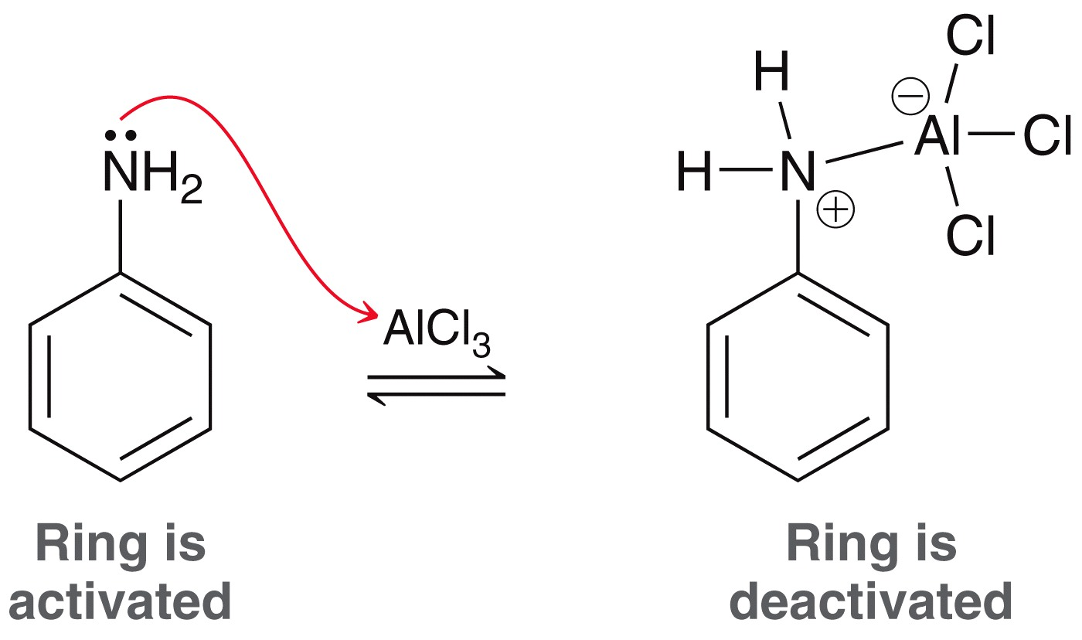
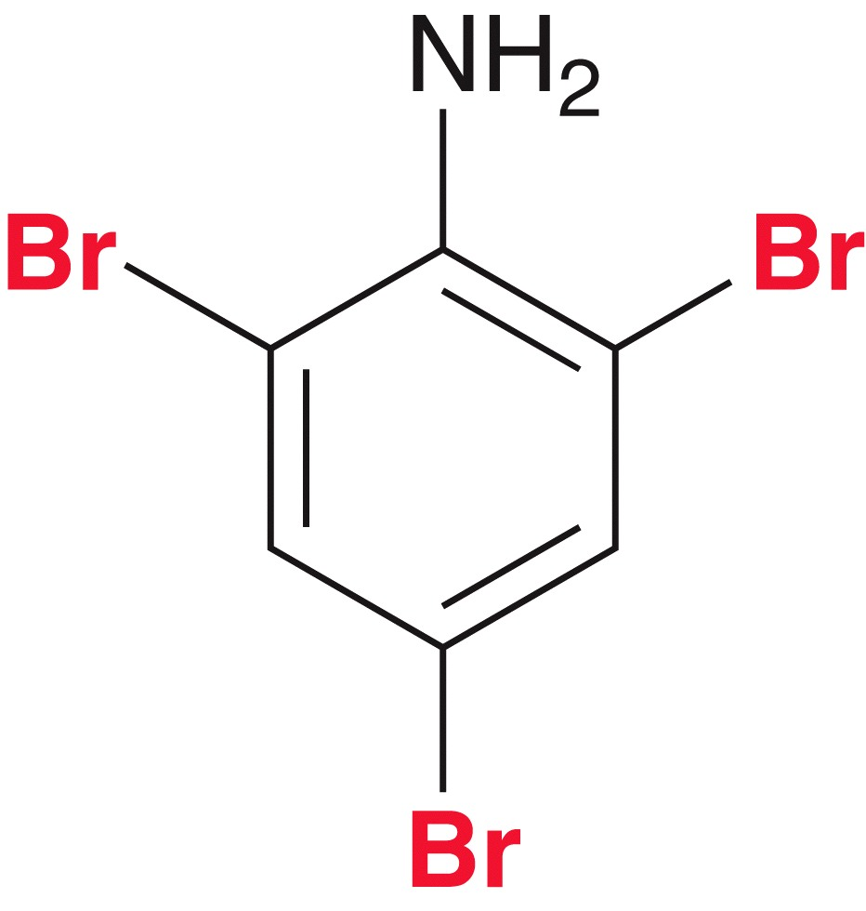
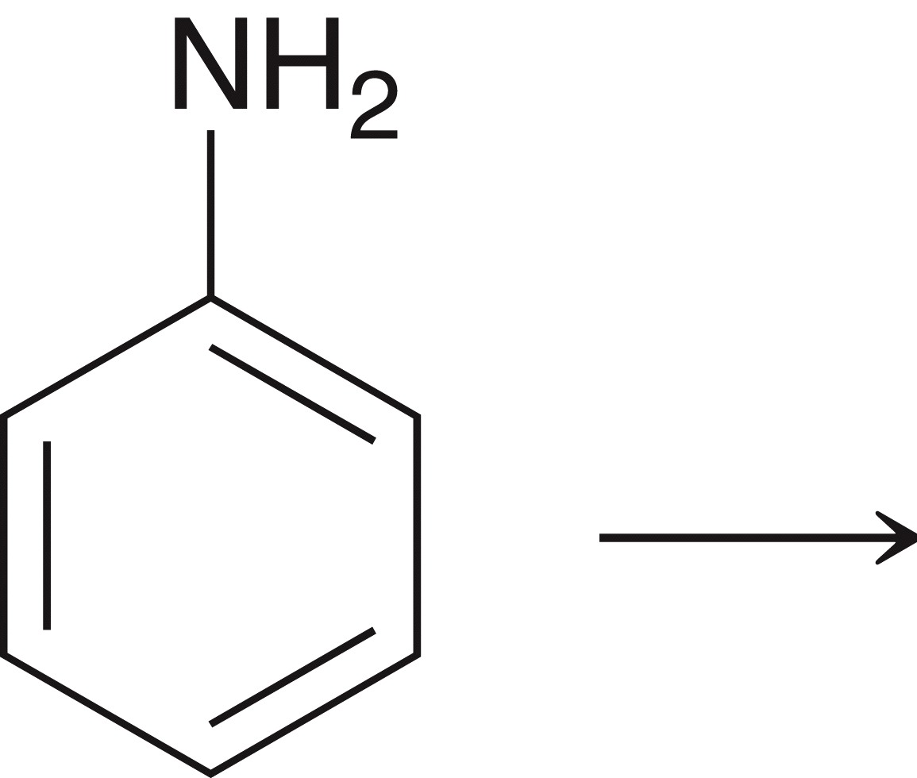
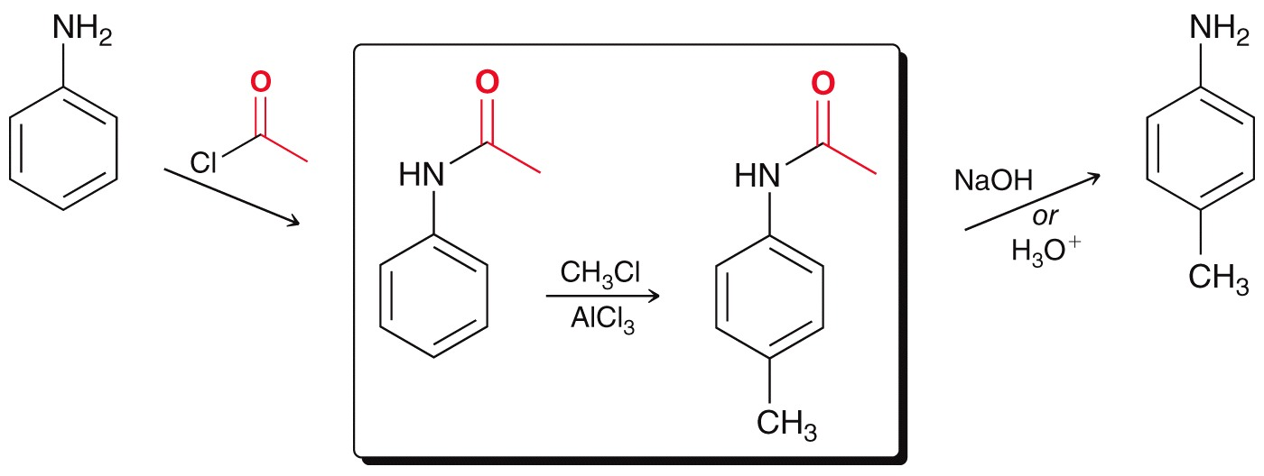
REACTION OF AMINES
Electrophilic Substitution of Aniline
Aromatic amines also can not undergo Friedel Crafts directly

Slide 30
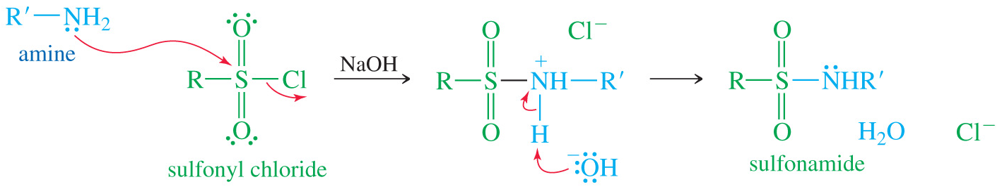
REACTION OF AMINES
Formation of Sulfonamides
Sulfonyl chlorides are the acid chlorides of sulfonic acids. Like acyl chlorides, sulfonyl chlorides are strongly electrophilic.
Primary or secondary amines react with sulfonyl chloride by displacing the chloride ion to give an amide.
Sulfa drugs are a class of sulfonamides used as antibacterial agents.

Slide 31
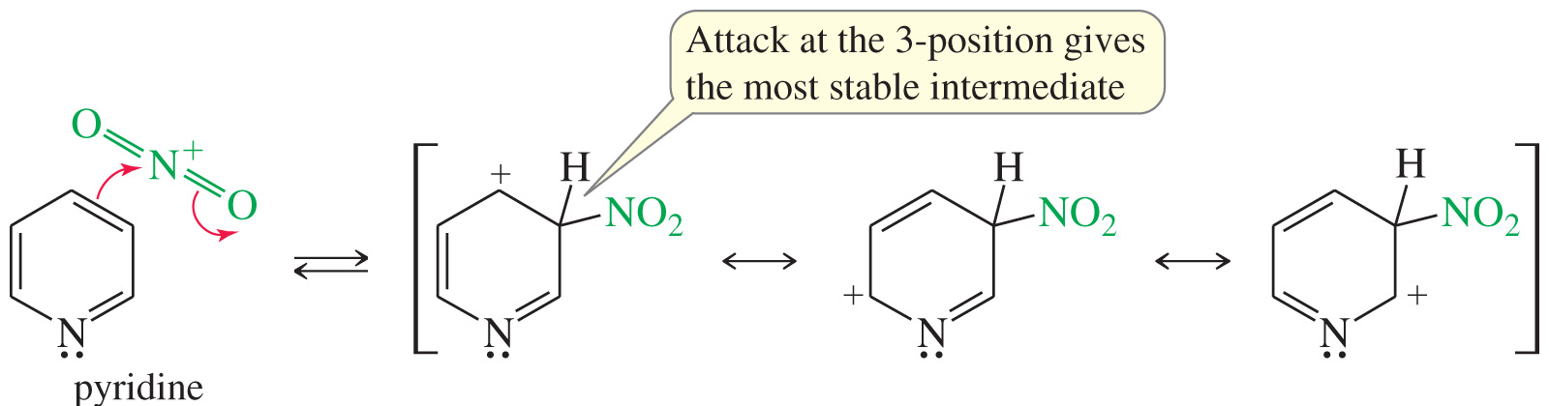
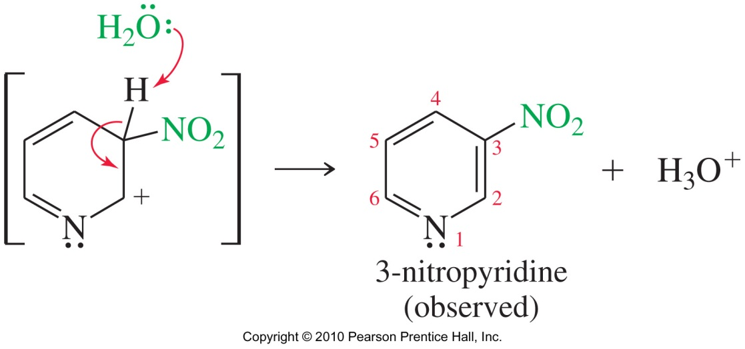
REACTION OF AMINES
Electrophilic Substitution of Pyridine
Strongly deactivated by electronegative N
Substitutes in the 3-position
Electrons on N react with electrophile

Slide 32
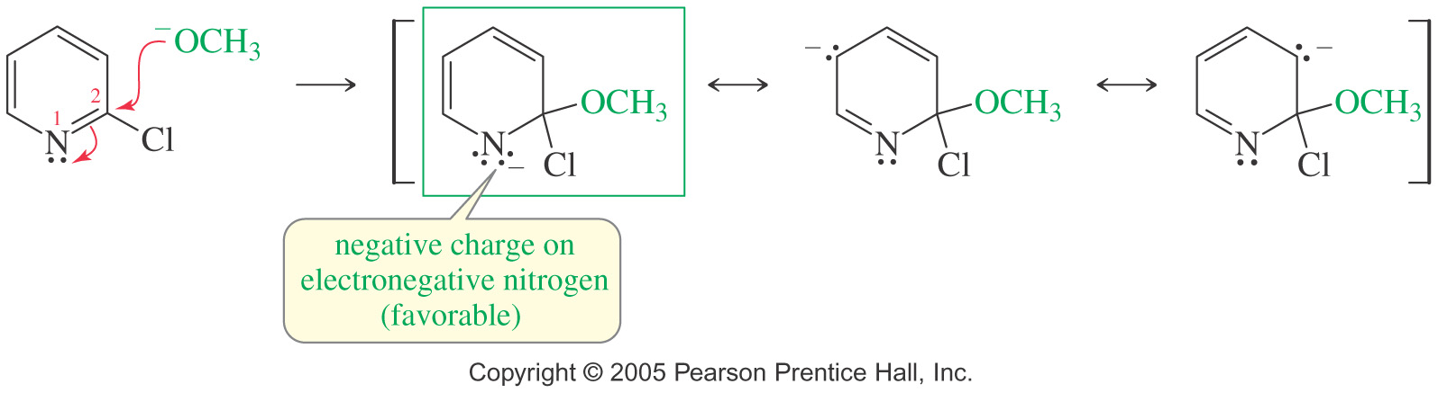
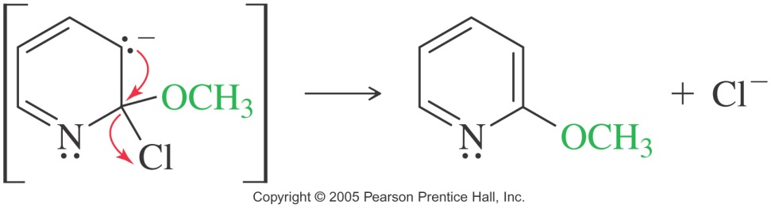
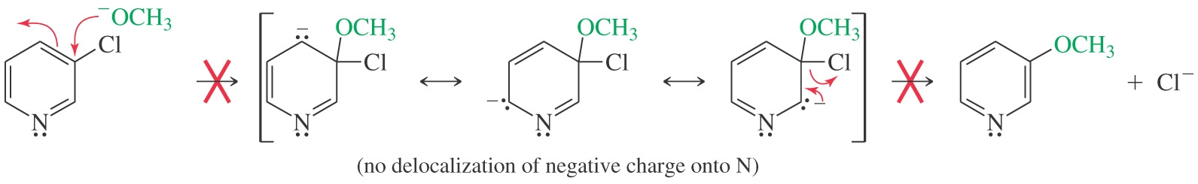
REACTION OF AMINES
Nucleophilic Substitution of Pyridine: Mechanism
Attack at the 2-position (observed)
Nucleophilic Attack at the 3-position (not observed)

Slide 33
REACTION OF AMINES
Examples: How would prepare the following compounds from pyridine or 2-chloropyridine

Slide 34
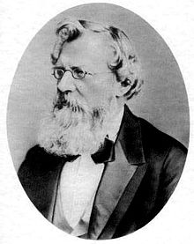
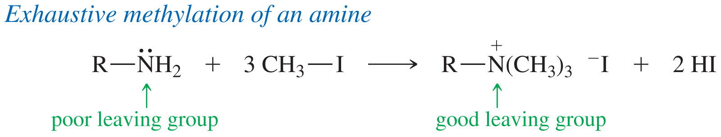
REACTION OF AMINES
Hofmann Elimination
Amines can be converted to alkenes by elimination reactions, much like alcohols and alkyl halides undergo elimination to give alkenes.
A quaternary ammonium salt is a good leaving group, and heating the hydroxide salt produces the least substituted alkene (Hofmann product).
August Wilhelm von Hofmann (8 April 1818 – 5 May 1892) was a German chemist who developed the Hofmann elimination.

Slide 35
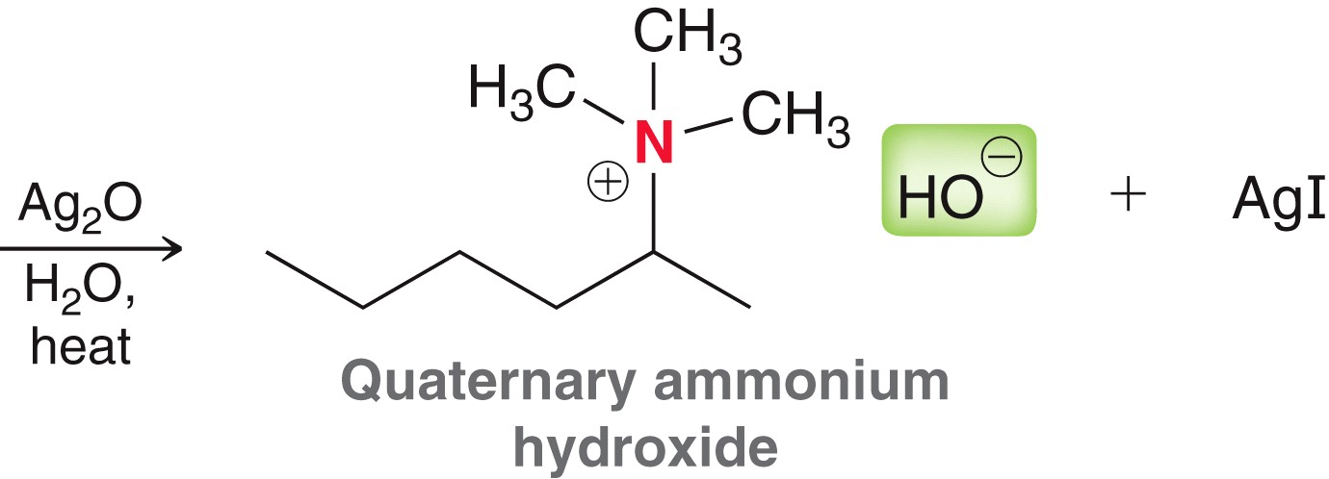
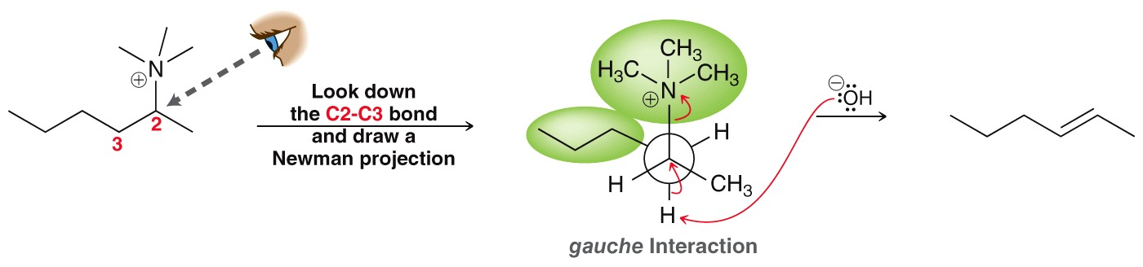
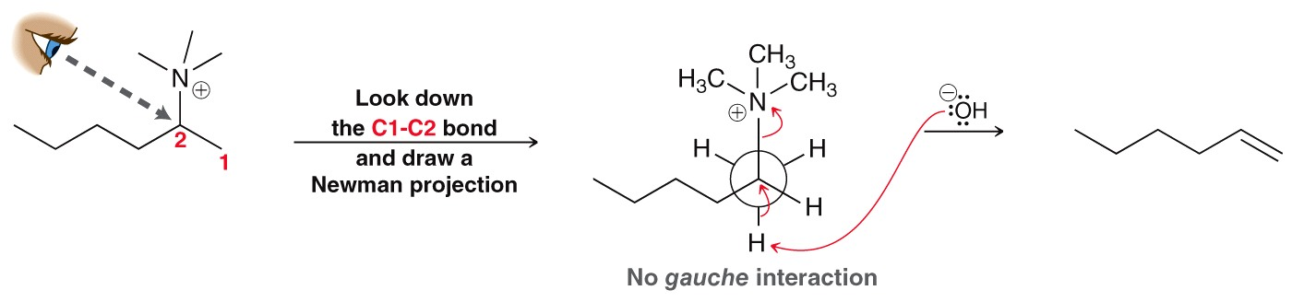
REACTION OF AMINES
Hofmann Elimination

Slide 36
REACTION OF AMINES
Oxidation of Amines
Amines are notoriously easy to oxidize (even in air), and oxidation is often a side reaction in amine syntheses.
Common oxidizing agents: H₂O₂ , MCPBA
2° Amines oxidize to hydroxylamine
3° Amines oxidize to amine oxide
The following partial structures show some of the bonding and oxidation states of amines

Slide 37
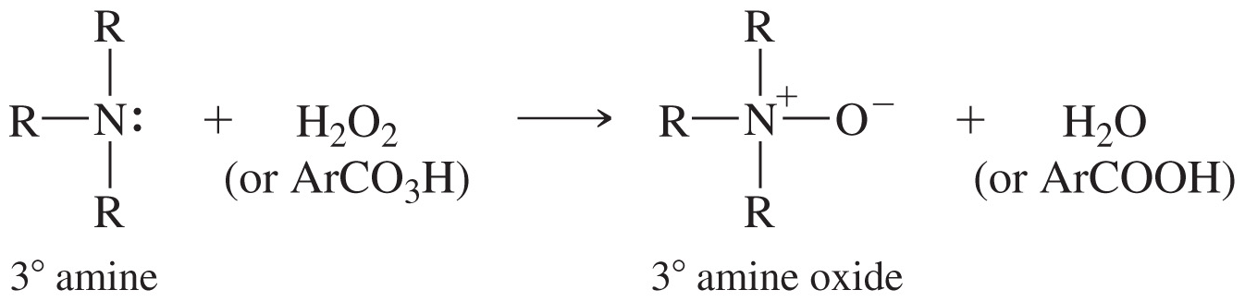

REACTION OF AMINES
Cope Elimination
Amine oxides undergo elimination to form the least substituted alkene under milder conditions than the Hofmann reaction
The amine oxide acts as its own base through a cyclic transition state, so a strong base is not needed

Slide 38
REACTION OF AMINES
Examples: Predict the major product (s) you would expect from the following reactions

Slide 39

REACTION OF AMINES
Reaction with Nitrous Acid
Primary amines react with nitrous acid, via nitrosnium ion, to give diazonium cations in the form of R-N⁺≡N. This procedure is called diazotization of an amine.
Step 1: The amine attacks the nitrosonium ion and forms N-nitrosoamine.
Step 2: A proton transfer (a tautomerism) from nitrogen to oxygen forms a hydroxyl group and a second N-N bond

Slide 40



REACTION OF AMINES
Reaction with Nitrous Acid

Slide 41


REACTION OF AMINES
Reaction with Nitrous Acid
Step 3: Protonation of the hydroxyl group, followed by the loss of water, gives the diazonium ion.
By forming and diazotizing an amine, an activated aromatic position can be converted into a wide variety of functional groups

Slide 42

REACTION OF AMINES
Arenediazonium Salts
In contrast to alkyldiazonium salts that are very unstable, arenediazonium salts are relatively stable in aqueous solutions around 0°–10°C, and are widely used for synthesis.
Above these temperatures, they decompose, and they may explode if they are isolated and allowed to dry.
The diazonium group can be easily replaced by many different functional groups.

Slide 43


NUCLEOPHILIC AROMATIC SUBSTITUTION
Diazonium ions

Slide 44


NUCLEOPHILIC AROMATIC SUBSTITUTION
Formation of N-Nitrosoamines
Secondary amines react with nitrous acid (HNO₂) to form N-nitrosoamines.
Secondary N-nitrosoamines are stable and have been shown to be carcinogenic in lab animals

Slide 45

SYNTHESIS OF AMINES
Reactions with C=O
Ammonia and primary amines react with carbonyls to give an imine (Schiff base).
The analogous reaction of a hydrazine derivative gives a hydrazone, and the reaction with hydroxylamine gives an oxime

Slide 46

SYNTHESIS OF AMINES
Reductive Amination
This method is the most general amine synthesis technique, capable of adding a primary or secondary alkyl group to an amine:
LiAlH₄ or NaBH₃CN can be used to reduce the oxime

Slide 47

SYNTHESIS OF AMINES
Reductive Amination
To produce a 2° amine, react an aldehyde or ketone with a 1° amine, then reduce the imine
To produce a 3° amine, react an aldehyde or ketone with a 2° amine, then reduce the imine salt

Slide 48


SYNTHESIS OF AMINES
Acylation-Reduction
This is the second general method for amine synthesis. Like reductive amination, acylation-reduction adds one alkyl group to the nitrogen atom of the starting amine.
An acid chloride reacts with ammonia or a 1° amine or a 2° amine to form an amide.
The C=O of the amide is then reduced to CH₂ with lithium aluminum hydride.
Ammonia yields a 1° amine.
1° amine yields a 2° amine.

Slide 49

SYNTHESIS OF AMINES
Acylation-Reduction - A 2° amine yields a 3° amine
Examples: Predict the major product (s) you would expect from the following reactions
Practice 23.14 to 23.17 P. 1121
23.18 P. 1123

Slide 50


SYNTHESIS OF AMINES
Gabriel Synthesis
The phthalimide ion is a strong nucleophile, displacing the halide or tosylate ion from a good SN₂ substrate.
Heating the N-alkyl phthalimide with hydrazine displaces the primary amine, giving the very stable hydrazide of phthalimide.

Slide 51


SYNTHESIS OF AMINES
Gabriel Synthesis: The mechamism
Siegmund Gabriel (7 November 1851-22 March 1924) was a German chemist.

Slide 52

SYNTHESIS OF AMINES
Gabriel Synthesis
Practice 23.12, 23.13 P. 118

Slide 53


SYNTHESIS OF AMINES
Syntheses limited to Primary Amines
Azide Reduction
Just as Gabriel used the anion of phthalimide to put the nitrogen atom into a primary amine, other nucleophile can also be used.
Azide ion, N₃⁻, is a good nucleophile that can displace leaving groups on unhindered 1° or 2° halide or tosylate through SN₂ mechanism.
The products are alkyl azides (RN₃), which no tendency to react further, but can be easily reduced to primary amines.
Alkyl azides are explosive! Do not isolate

Slide 54



SYNTHESIS OF AMINES
Syntheses limited to Primary Amines
Formation and reduction of Nitrile
Nitrile (C≡N) is a good SN₂ nucleophile
Reduction with H₂ or LiAlH₄ converts the nitrile into a primary amine
Practice 23.10, 23.11 P.1115

Slide 55


SYNTHESIS OF AMINES
Reduction of Nitro Compounds
The nitro group can be reduced to the amine by catalytic hydrogenation or by an active metal and H⁺.
Commonly used to synthesize anilines

Slide 56

SYNTHESIS OF AMINES
Syntheses limited to Primary Amines
Hofmann Rearrangement of Amides
In the presence of a strong base, primary amides react with chlorine or bromine to form shortened amines, with the loss of the carbonyl carbon atom.
This reaction, called the Hofmann rearrangement, is used to synthesize primary and aryl amines

Slide 57




SYNTHESIS OF AMINES
Hofmann Mechanism

Slide 58
SYNTHESIS OF AMINES
Examples: Predict the major product (s) you would expect from the following reactions
Problems 23.49 to 23.51, 23. 58 to 23.62, 23.70 P. 1146-1147

